Slide 1
Sarvalanche -S1 Avalanche Detection Pipeline
Dr. Zachary Hoppinen
February 2026

Slide 2
What is sarvalanche
Python package that handles data finding, reprojection, differencing, and detection for avalanche debris. Pytest implemented.
How does it work? Combines static probabilities of avalanches debris (slope, fcf, runout probability, water mask) with SAR features (local resolution weighted backscatter change currently)
IO – we get S1 (opera rtcs, local resolution), forest cover, slope angles, UCLA snowmodel SWE, and run the FlowPy debris flow model over a dem to generate runout cell counts.

Slide 3
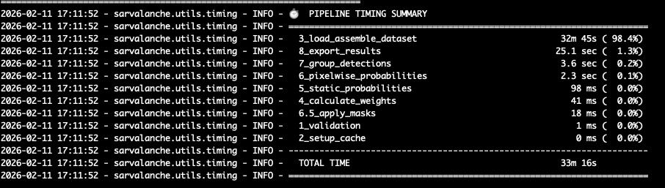
What is sarvalanche
Runtime – over most of Sawtooth Mountains full run (including flowpy modeling (95% of time) takes 33 minutes. Non-flowpy run time = 2 minutes, data-loaded already = <1 minute.

Slide 4
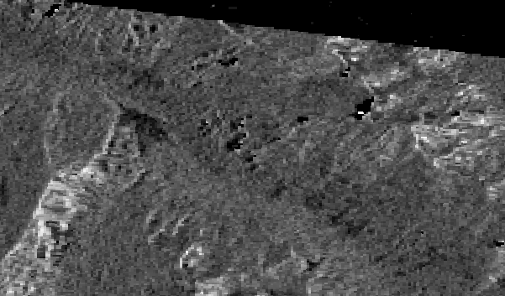
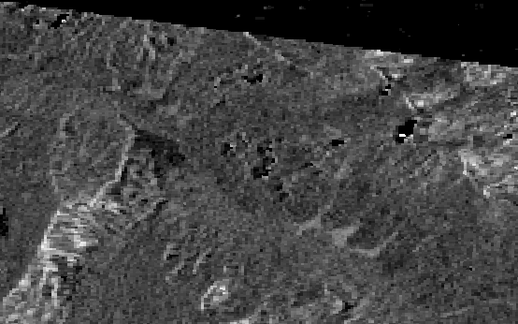
Example
March 31st – Major earthquake triggered avalanche cycle in the Sawtooths
Before – March 30th – Track 71
Avalanches – April 5th – Track 71

Slide 5
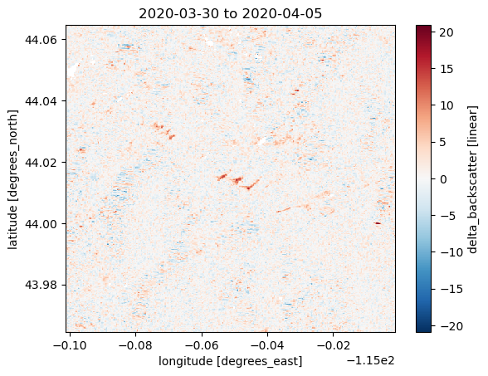
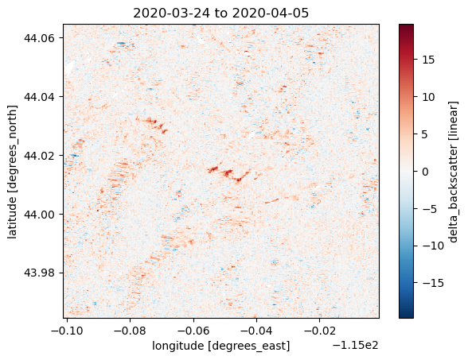
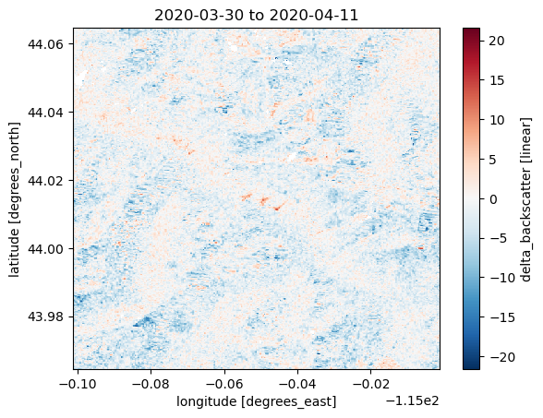
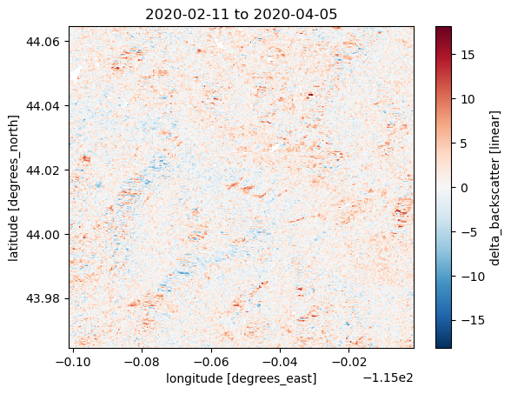
We start with dB of backscatter change over specific date (2020-03-31) from each track from all possible pairs (within a few months). These are all examples crossing 3/31 from same orbit geometry.
Example avi increases
are visible even for pairs
months apart

Slide 6
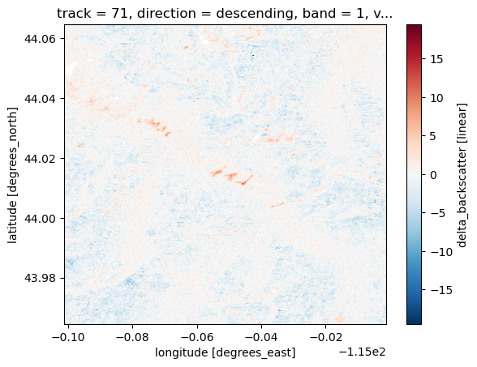
These are weighted by temporal distance between each pair to generate a track based mean change that weights closer pairs more
w_temporal = np.exp(-np.abs(dt_days) / tau_days)
With tau_days = 24 currently

Slide 7
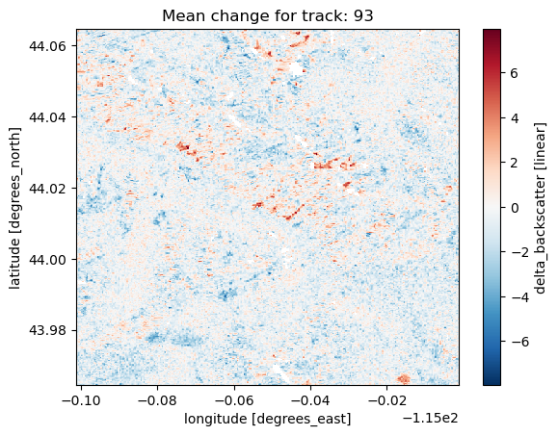
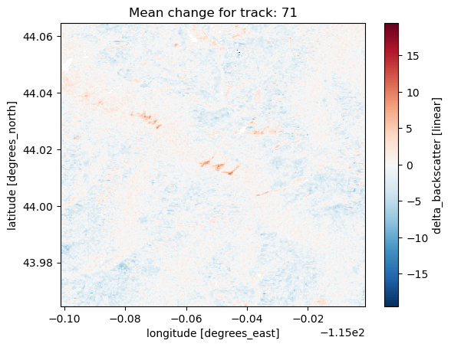
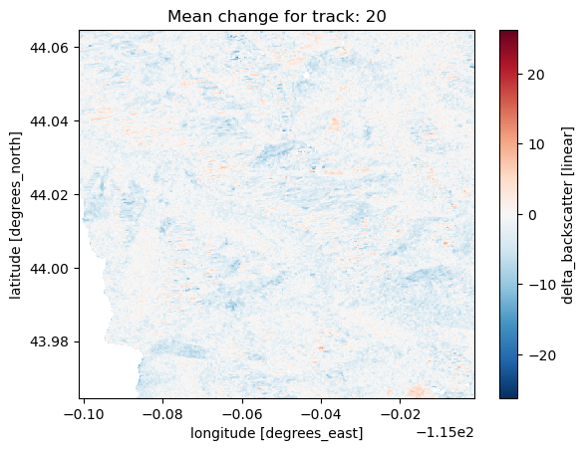
This is repeated for all available tracks
A track is “orbital geometry” basically the satellite hits the same area going north and south and sometimes on the close and far edges of radar beam.

Slide 8
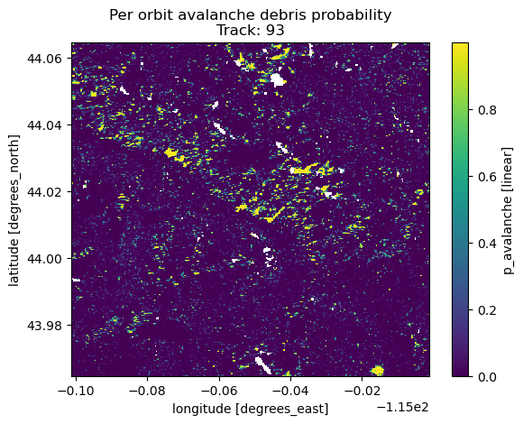
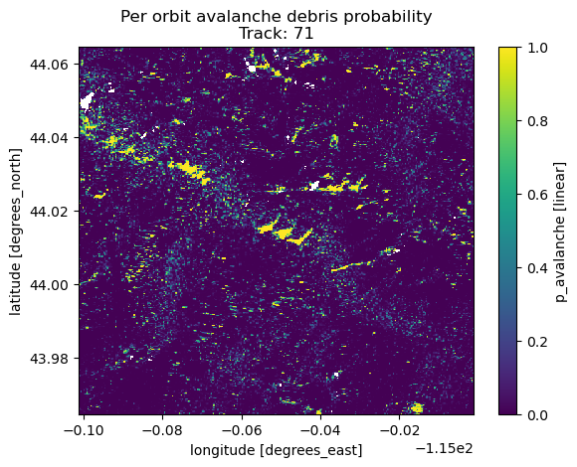
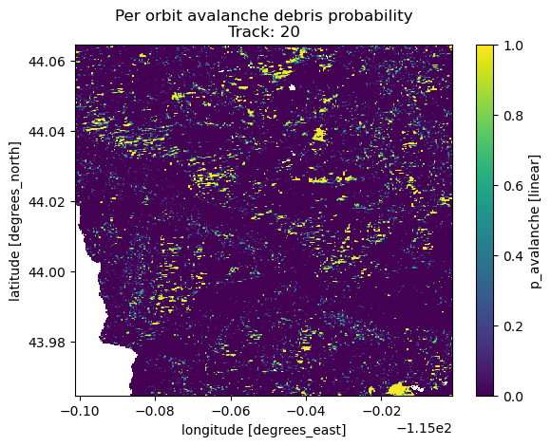
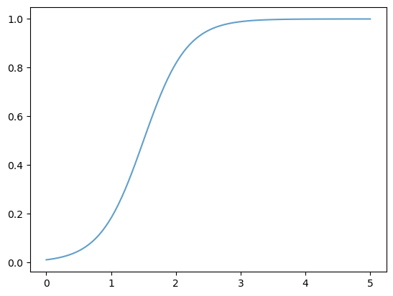
We convert this mean change to a probability
prob = scipy.expit(diff - threshold_db)*logistic_slope
We show the probability to backscatter change to the right
Probability
Backscatter change [dB]

Slide 9
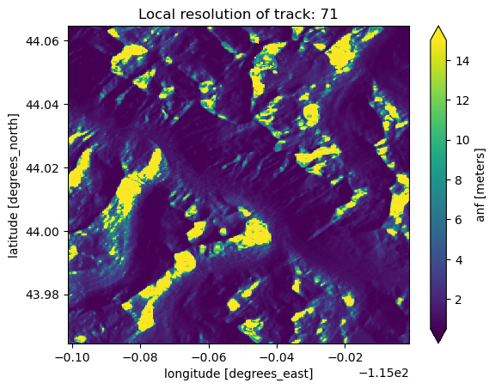
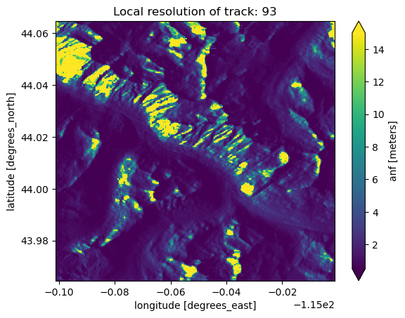
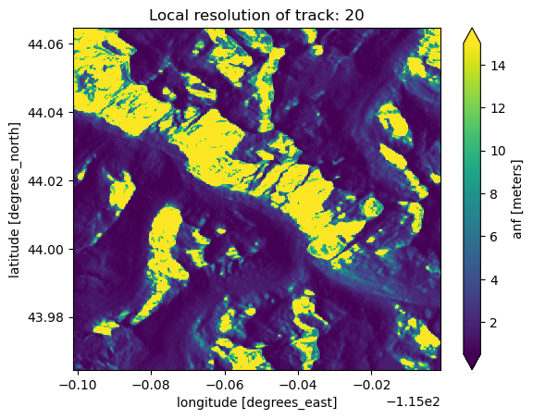
These are then combined using the inverse of local resolution of each pixel to weight the relative tracks.
So lower local resolution == less weight for final probability
Radars look to the side and sample based on fixed time slices so steeper incidence angles have less ground covered (local resolution) by a fixed time snippet of the radar response.
We also use a relative weighting of VV vs VH (1.0 vs 0.8)

Slide 10
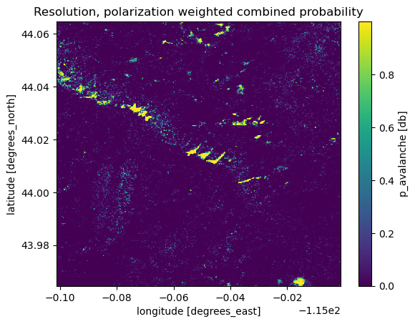
Combining probabilities from multiple tracks
We combine using log odds to minimize outliers
We also add an “agreement” boost when multiple orbits show greater than 0.5 probability.
The result is probabilities that are seen from multiple change pairs, multiple orbits, in high resolution areas all get higher probability.

Slide 11
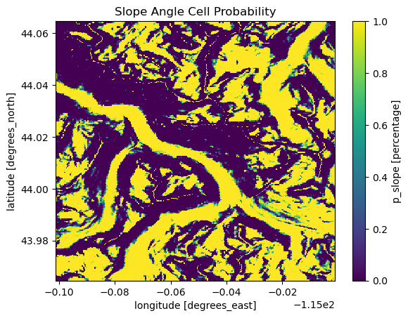
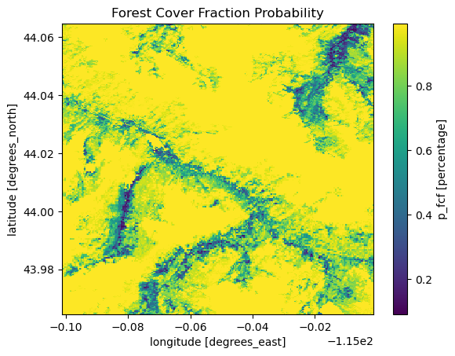
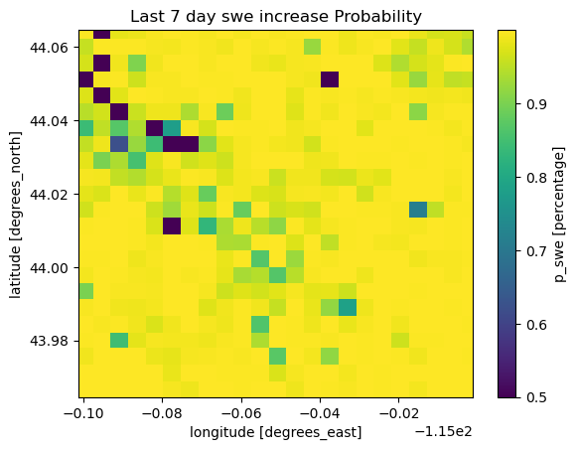
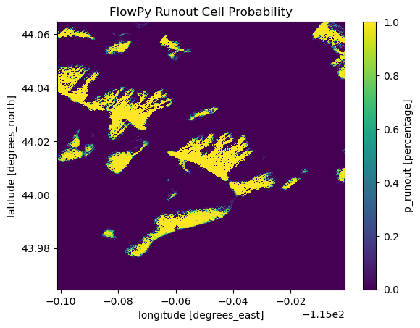
This is then combined (geometric mean this time) with non-SAR probabilities
Probably all intuitive except for:
Runout Cell – does this pixel get “hit” by any start zones in the flowpy model
SWE increase – does that pixel see SWE increases over the alst 7 days?

Slide 12
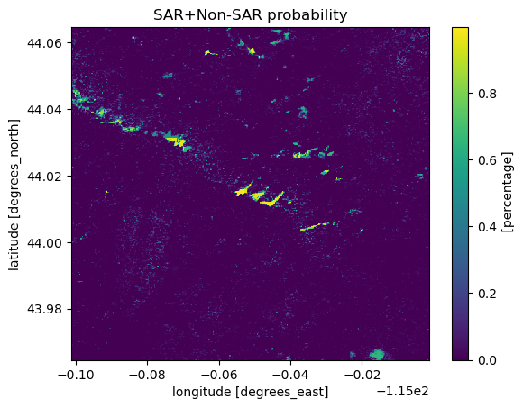
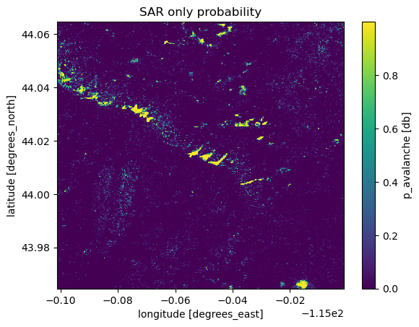
Combine SAR and Non-SAR probabilities.
Non-SAR layers can not increase pixel-wise probability from SAR results but can decease it.
Reduces probability when 1. not in runout zones, 2. steep angle, 3. high fcf, 4. little recent SWE.
Completely masks: urban and water

Slide 13
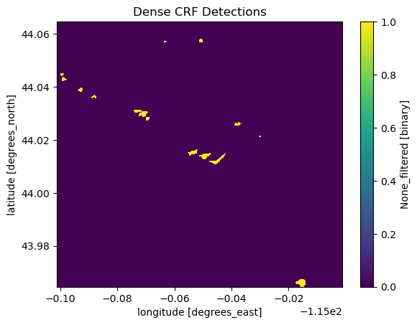
Last step: Use dense conditional random fields (CRF) to give weight to pixels near other debris pixels and remove sharp changes in debris/background

Slide 14
Re state example with detections
March 31st – Major earthquake triggered avalanche cycle in the Sawtooths
Avalanches – April 5th – Track 71

Slide 15
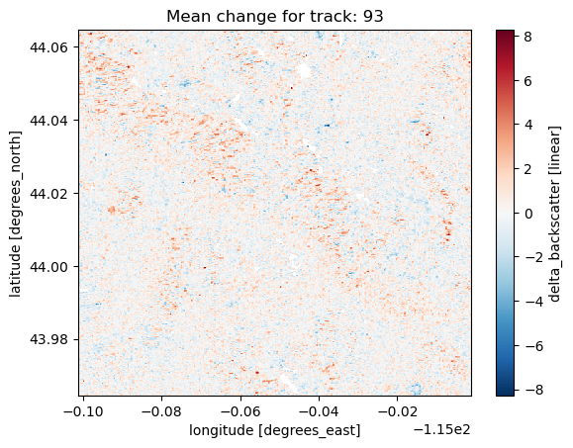
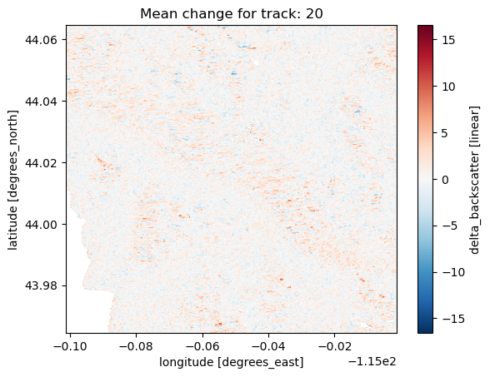
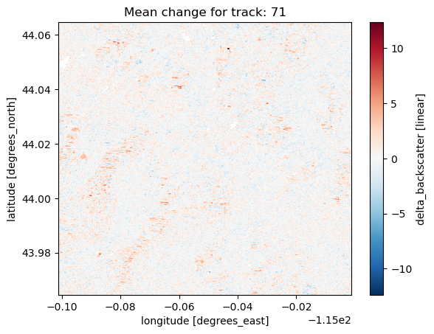
Re-run again on Jan 31st, 2020 for an example of minimal avalanches

Slide 16
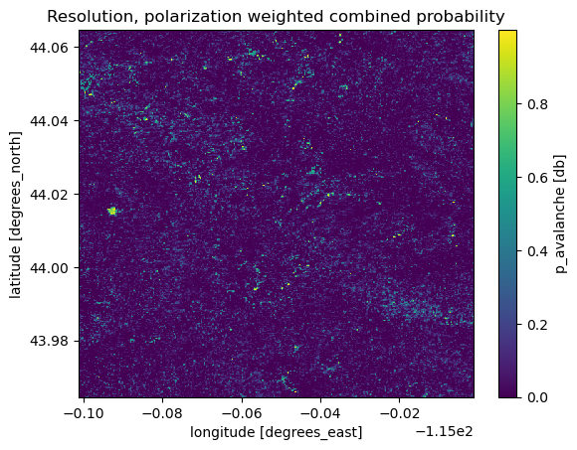
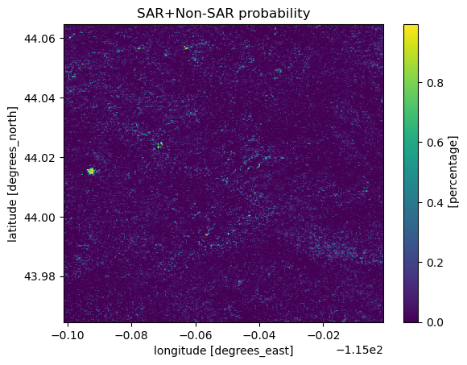
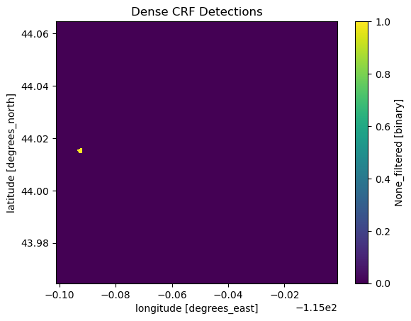
Re-run again on Jan 31st, 2020 for an example of minimal avalanches
Single detection for
non-avalanche date

Slide 17
Next Steps?
ISSW presentation – run over last 5 years over each of the western US avalanche regions to generate database for other researchers. What level of temporal specificity? Yearly? Monthly? Daily?
Processing improvements:
Multi-temporal. When does an avalanche first appear in a SAR scene = set as detection date.
Use backscatter distributional changes in addition to backscatter change
Use empirical detections to train ML model (unet) based on empirical detections and then re-run and capture more detections
Incorporate other/more sentinel-1 coherence and NISAR based pixel based probability pipelines.

